Slide 1

POWERPOINT
TEMPLATE
PRESENTED BY OfficePLUS

Slide 2
01
点击此处添加标题
02
点击此处添加标题
CONTENT
03
点击此处添加标题
04
点击此处添加标题

Slide 3
1
Substance Addiction
in Ancient China

Slide 4
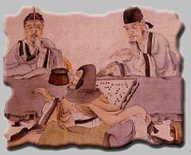
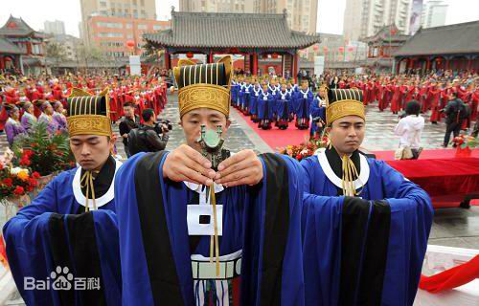
Alcohol Use in Ceremony
In traditional Chinese religious and sacrificial ceremony, wine is used as the carrier to pray for god's blessing on the human welfare and to cherish the memory of ancestors, deceased relatives and friends.
In interpersonal etiquette, the wine is very important. When proposing a toast, the elder comes first.
《前汉书·食货志第四下》: “百礼之会，非酒不行。”
“青梅煮酒论英雄”

Slide 5
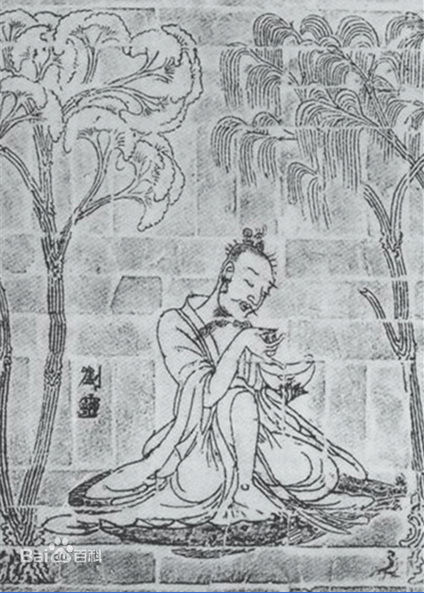
Drinking Behavior
刘伶(Liu Ling)： A famous litterateur in Wei-Jin period，one of Seven Sages of The Bamboo Grove.
枕曲藉糟[zhěn qū jiè zāo](《晋书·刘伶传》) :
rest head on the wine，sit on the mash after brewing
荷锸任埋[hè chā rèn mái ](《晋书-卷四十九》):
take with a bottle of wine when going out and ask his servant to take with a spade in order to bury him wherever he dies.
以酒醒酲[yǐ jiǔ xǐng chéng](《世说新语·任诞》):
sobering up by drinking wine

Slide 6
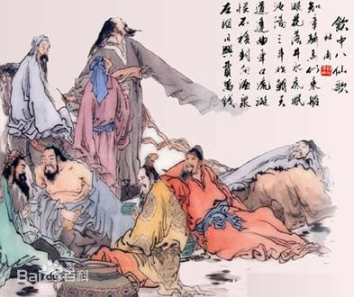
Drinking Behavior
饮中八仙歌
The Ode of Eight Immortals Indulged in Wine
杜甫[Du Fu]
知章骑马似乘船，眼花落井水底眠。
汝阳三斗始朝天，道逢麴车口流涎，恨不移封向酒泉。
左相日兴费万钱，饮如长鲸吸百川，衔杯乐圣称避贤。
宗之潇洒美少年，举觞白眼望青天，皎如玉树临风前。
苏晋长斋绣佛前，醉中往往爱逃禅。
李白斗酒诗百篇，长安市上酒家眠，天子呼来不上船，自称臣是酒中仙。
张旭三杯草圣传，脱帽露顶王公前，挥毫落纸如云烟。
焦遂五斗方卓然，高谈雄辩惊四筵。

Slide 7
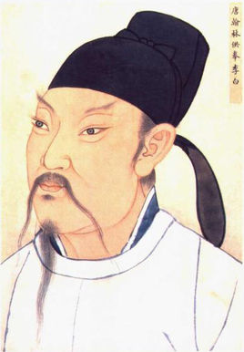
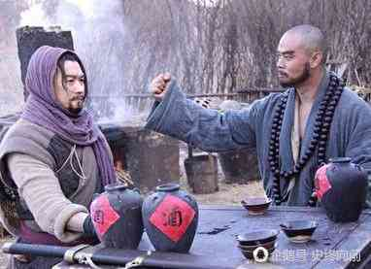
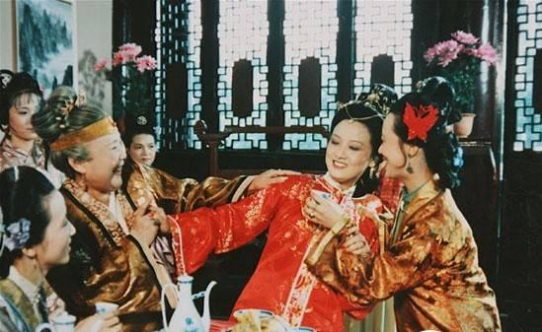
in Literature
poem：
《饮中八仙歌》；
李白[Li Bai]：
百年三万六千日，一日须倾三百杯。——《襄阳歌》
兴酣落笔摇五岳。——《江上吟》
烹羊宰牛且为乐，会须一饮三百杯。——《将进酒》
novel：
A Dream in Red Mansions，Water Margin：
There are a lot of scenes describing people drinking

Slide 8
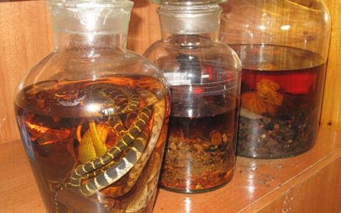
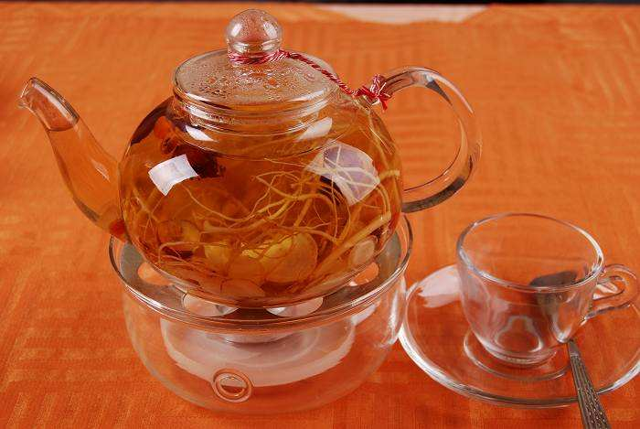
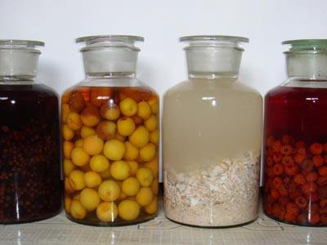
Regimen through Wine
People put some substances in the wine. After soaking for a certain period， people will drink the wine.

Slide 9
Traditional Method
heal
relieve
生葛根汁饮二升,便愈。
——《本草纲目》
云葛根： “…开胃下食,解酒毒。”
——《千金方》
酒七升着瓶中，熟朱砂半两着酒中，急塞瓶口，安猪圈中，任猪喙动，经七日取尽饮之，永断。
——《千金方》
嗜酒不已,毡中苍耳子七枚,烧灰投酒中饮之,即不嗜。
——《本草拾遗》
cut out forever
like

Slide 10
From Papaver to Opium
1
Introduction
2
Flower Admiration
3
Medicine
Papaver cultivation technique was introduced in China in late AD7.
In Tang dynasty, papavers were mainly used for flower admiration.
During the Song and Yuan dynasties, the medical function of papaver was highly valued and widely used .
Introduction
Opium Addiction
Opium was introduced in Ming dynasty.
In Qing dynasty, with the invention and dissemination of the mixed tobacco smoking method, opium began to be abused and became a drug to harm the society.
1
2

Slide 11
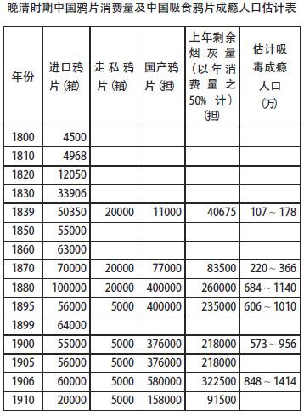
Opium Use and Addiction in Late Qing Dynasty
Lu Jikang(2014)
The data are extrapolated from History of Foreign Relations of The Chinese Empire, Customs Report, History of Drugs in China and so on.
The population in 1851 is 436 million.

Slide 12
First Opium War
China-UK
trade
opium
prohibition
opium
destroy
outbreak of the war
consequence of the war
In order to reverse the trade deficit with China, the UK began to smuggle opium into China.
The problem of opium addiction caused serious social problems, so the Qing government enforced the ban on opium.
Lin Zexu seized more than 20,000 boxes of opium and burnt them in the Humen beach.
Britain started the war on the grounds of invasion of private property.
After the first opium war, China and Britain signed the Treaty of Nanking.

Slide 13
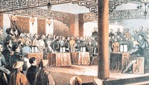
Second Opium War
After signing the Treaty of Tianjin, the UK, France and the US signed another treaty——《通商章程善后条约》 with the Qing government.
The opium trade was legalized in China.
This aggravated the social problems caused by the opium trade.

